Slide 1
YOUNG PEOPLE IN THE LEAD TRAINING
Modules available in this series:
Module 1: Facts About Care & Custody
Module 2: Trauma Informed Working
Module 3: Building Relationships
Module 4: Developing Independence
Module 5: Spaces & Places
Module 6: Boundaries
Module 7: Consultation & Participation
Module 8: Staff Wellbeing

Slide 2
MODULE 1
Facts & Figures
This resource is part of the Informing Futures toolkit www.informingfutures.co.uk It was co-created with young people, and reflects what they felt practitioners most needed to understand in order to work successfully with care and custody experienced young people.
For more information or queries on any of the topics covered in this toolkit, or to find out about training and consultancy we can offer please contact enquiries@1625ip.co.uk
Special thanks to all the young people who took part in YPIL directly or supported our research for these resources: Ahmed, Alexis, Ashraf, Curtis, Ethan, John, Michael, Nikita, Rowen, Tia-Louise, & Tyler-Jack
Copyright© 2020 Informing Futures is a 1625 Independent People project.
Copyright© 2020. Informing Futures, a 1625 Independent People project.

Slide 3
MODULE 1: FACTS & FIGURES
Who are we talking about?
Why do young people go into care or custody?
Where do we come in?
Capricorn – group activity
Notes:
Introduce topic and what we will be covering today:
Who are we talking about?
Why do young people go into care or custody?
Where do we come in? A bit about what we as professionals, as well as society at large, can contribute, as well as introducing two government led pieces of work on this topic.

Slide 4
WHO ARE WE TALKING ABOUT?
Care and custody leavers
Those at risk of custody
Those in care or custody
They could be anyone you meet. Being a Care Leaver is a characteristic that isn’t obvious, and being in custody doesn’t have to define the rest of your life. We should avoid ‘othering’ these groups in the same way we shouldn’t ‘other’ any others!
Notes:
Today are we covering an introduction to two differing, but related, groups of young people who we may work with. Young people who are to varying extents involved in the care and/or custody systems.
We should avoid ‘othering’ these groups in the same way we shouldn’t ‘other’ any others! This said, it is sometimes helpful as professionals working with young people to consider the needs of young people who have had similar experiences and may present and behaviour in some similar ways. Which may include having further ‘additional needs’. In addition another commonality between young people in care and young people in custody is that neither group is living with their family unit where as many ‘other’ young people may well be.

Slide 5
QUIZ TIME!
How many young people are in care in England?
a) Who looks after young people in care? b) Where do they live?
How do children in care do in their GCSEs?
What percentage of care leavers go to University?
What percentage of care leavers aren’t in EET at all?
What does UASC stand for?
How is homelessness, being in care and being in custody all linked?
Notes:
Lead the training group through a discussion with the questions listed on the slide as starting points and welcome thoughts and ideas from the group. Then read out the information below which goes some way to answer these questions. Option to tell people where the data comes from via references if asked/relevant.
1. Approximately 75,000 children are in care in England (Coram. 2018. Public attitudes to children in care results from a national survey. Can be found HERE.), At 31 March, the number of children looked after (CLA) by local authorities in England increased by 4% since 2018 to 78,150 - continuing increases seen in recent years. (Department of Education and National Statistics: National Statistics Children looked after in England including adoption: 2018 to 2019). This equates to 1% of all young people. A further 50,000 are on a ‘child protection plan’, so could be deemed as at risk.
2. a) In England the government becomes ‘Corporate Parent’ to anyone in care. All young people who leave care at 16, 17 or 18 are provided with statutory support, in the form of a ‘Local Offer’. This should include help in the transition to living independently; support with finding accommodation and with any costs of participating in education, training and employment.
However, in order to provide a greater level of support at this crucial stage during the transition of care leavers to adulthood, wider society also needs to play a part. (Care Leavers Covenant Website 2020)
b) 75% of cared for children are fostered, the remaining 25% are in residential care (what were called childrens’ homes). Young people who turn 18 may have the option to ‘stay put’ with their foster carer(s) but this becomes an ‘arrangement’, or ‘stay close’ staying the locality of their residential care placement, which is available in some places (HM Government Keep on Caring Supporting Young People from Care to Independence July 2019)
3. 2018 figures from the UK Government suggest that 17.5 % of children in care achieve a good pass (grade 4 or above) in English and Maths. This is compared with 59.4 % of non-looked after children. https://assets.publishing.service.gov.uk/government/uploads/system/uploads/attachment_data/file/794535/Main_Text_Outcomes_for_CLA_by_LAs_2018.pdf
4. Only 7% of children in care gain entry to University. (DfE. 2012. Outcomes for Children Looked After by Local Authorities in England: as at 31March 2012. DfE; DfE. 2015. Children looked after in England (including adoption and care leavers) year ending 31 March 2015. DfE. Can be found HERE)
5. 40% of all care leavers aged 19-21yrs in England are not in employment, education or training, referred to as being ‘NEET’. (DfE, National Statistics. 2017. Children looked after in England (including adoption), year ending 31 march 2017. Can be found HERE.)
6. ‘Unaccompanied Asylum Seeking Child’. Any unaccompanied children in the UK fall into the group of young people who are ‘in care’, including UASC. For UASC upon entering the UK aged 18 or under without a guardian over 18 a child becomes ‘looked after’ by the local authority after having been accommodated by the local authority under section 20(1) of the Children Act 1989 for 24 hours. This will mean that they will be entitled to the same local authority provision as any other looked after child. The number of UASC increased by 11% to 5,070 and they represent around 6% of all children looked after in England. (Department for Education. Care of unaccompanied migrant children and child victims of modern slavery Statutory guidance for local authorities. November 2017)
Another, related group of young people include young people who have been trafficked into the UK, either for ‘modern slavery’ (being forced or coerced into a life of labour and/or servitude) or other forms of exploitation, such as Child Sexual Exploitation (CSE) or Child Criminal Exploitation (CCE), which may involve being forced to drug running often as part of ‘county lines’. These groups are likely to have often have complex needs that are in addition to those complex needs faced by looked after children more generally. (Department for Education. Care of unaccompanied migrant children and child victims of modern slavery Statutory guidance for local authorities. November 2017)
7. 20% of young homeless people have previously been in care (Homeless link research team. 2018. Young and homeless 2018. Can be found HERE), so if we compare this to the fact just 1% of children are in care, the risk of becoming homeless increases if you have been in care. Fewer than 1% of young people are in Care, but looked after children make up 33% of boys and 61% of girls in Custody.

Slide 6
QUIZ TIME!
How many young people are in custody in England?
Have the numbers of young people in custody been going up or down?
What was the main reason, in 2017/18 for a young person being in custody?
Do more young men or young women enter custody?
What percentage of children carry knives?
Notes:
Lead the training group through a discussion with the questions listed on the slide as starting points and welcome thoughts and ideas from the group. Then read out the information below which goes some way to answer these questions. Option to tell people where the data comes from via references if asked/relevant.
A quick note that most data available relating to custody and young people is readily available for children, those ages 10-17, and sometimes includes those who are 18. However it is harder to find clear data grouped for ‘young people’ grouped as being aged 16-25.
All data cited relates to England and Wales.
1. In November 2019, the overall population of the secure estate for children and young people, including those aged 18 years old, was 837. (HM Government Official Statistics Youth Custody data Jan 2020)
In every ethnic group, the number of young people in youth custody went down between 2005/06 and 2017/18, HOWEVER it rose for Black young people. (HM Government Ethnicity Facts and Figures Young People in Custody June 2019). The number of arrests has also gone down. There were over 65,800 arrests of children (aged 10-17) by the police in England and Wales (excluding Lancashire, who ‘couldn’t provide data’). This has decreased by 78% over the last ten years, with a decrease of 8% in the last year. (Youth Justice Board / Ministry of Justice. Youth Justice Statistics 2017/18 England and Wales. Jan 2019). When compared to each other the custody and arrest figures demonstrate that the majority of young people arrested do not receive a custodial sentence.
The simple answer is ‘violence against the person’, however again this differs across ethnic groups. White young people were more likely to be in custody due to a sexual offence, and black young people due to violence against the person. Other reasons include drug related charges, robbery, domestic burglary, and breach of a statutory order. (HM Government Ethnicity Facts and Figures Young People in Custody June 2019)
In 2017/18 this was young men, at 84%.
In March 2018 0.5% of children ages 10-15 reported that they had carried a knife for their own personal protection in the past 12 months. Whilst this sounds low, that is still quite a shocking statistic. In addition whilst the overall number of offences involving a knife or offensive weapon has increased in each of the last four years, the proportion of these offences committed by a child has ALSO increased in each of the last four years. (Youth Justice Board / Ministry of Justice. Youth Justice Statistics 2017/18 England and Wales. Jan 2019).

Slide 7
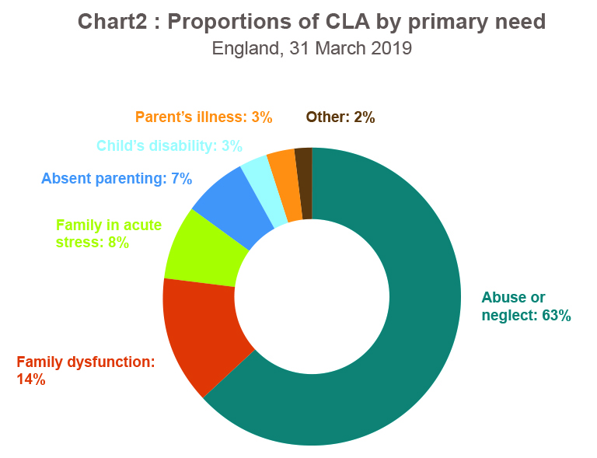
WHY DO YOUNG PEOPLE GO INTO CARE?
Two thirds of children enter care as a result of abuse and neglect.
As mentioned before some enter care as a result of fleeing their home country and seeking asylum, or being trafficked into the country for exploitation.
UASC represent 6% of children in care. They may fall into various categories on the pie chart, with the biggest primary need usually being absent parenting (87% for UASC vs 7% across all young people entering care).
(Department of Education National Statistics Children looked after in England including adoption: 2018 to 2019)
Notes:
Ask the training group the question before revealing and talking through bullet points.
Two thirds of children enter care as a result of abuse and neglect (Department of Education Policy paper Principles to guide higher education providers on improving care leavers access and participation in HE, 2019)
Talk through the graph, which shows the various reasons a child may go into care, by percentage.
When a child is assessed by children’s services their primary need is recorded. There are a range of reasons why a child is looked after including being looked after:
• as a result of or because they were at risk of abuse or neglect - 49,570 children - the most common reason identified
• primarily due to living in a family where the parenting capacity is chronically inadequate (family dysfunction) - 11,310
• due to living in a family that is going through a temporary crisis that diminishes the parental capacity to adequately meet some of the children’s needs (family being in acute stress) - 6,050 A crisis could be lined to a number of things, and may be financial, up to the risk of homelessness, be due to a sudden bereavement.
due to there being no parents available to provide for the child - 5,410
due to the child’s or parent’s disability or illness - 4,580 which would include being unwell due to mental illness.
• due to low income or socially unacceptable behaviour – 1,230.
(Department of Education National Statistics Children looked after in England including adoption: 2018 to 2019)

Slide 8
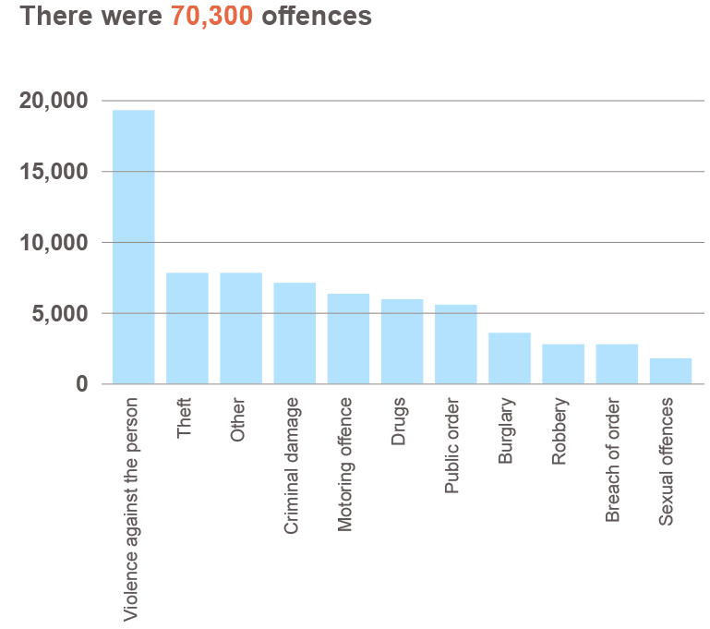
WHY DO YOUNG PEOPLE GO INTO CUSTODY?
A court can give a young person a custodial sentence if:
the crime is so serious there is no other suitable option
the young person has committed crimes before
the judge or magistrate thinks the young person is a risk to the public
Why do young people commit crimes?
Youth Justice Statistics, 2017/18 England and Wales. Data for 10-17yrs old.
Notes:
Talk through graph, flagging that this is for children, aged 10-17yrs.
Note there is a big difference in how criminal activity is treated across youth services and adult services, that offences are dealt with differently and that the transition is hard.
A court can give a young person a custodial sentence if:
the crime is so serious there is no other suitable option
the young person has committed crimes before
the judge or magistrate thinks the young person is a risk to the public
A young person can also be sent to custody on remand. The Youth Justice Board decides which secure centre a young person will be sent to. They will choose somewhere that:
can deal with the young person’s needs safely, eg if they have a health problem
is suitable for their age, sex and background
is as near to their home as possible
There are 3 types of custody for young people:
young offender institutions are run by the Prison Service and private companies are for people aged 15 to 21 (people under 18 are held in different buildings).
secure training centres are run by private companies are for people aged up to 17
secure children’s homes run by local councils and are for people aged 10 to 14
Ask training group: How often can professionals supporting a young person in custody visit them? Correct answer: Usually, you can visit a young person once a week if you are a family member or friend, but this can vary.
Ask training group: Who are the Youth Offending Team? Correct answer: Youth offending teams work with young people that get into trouble with the law. They look into the background of a young person and try to help them stay away from crime.
They also:
run local crime prevention programmes
help young people at the police station if they’re arrested
help young people and their families at court
supervise young people serving a community sentence
stay in touch with a young person if they’re sentenced to custody
Ask training group: Why do young people commit crimes? Jot their thoughts onto a big sheet of flipchart paper.
Add anything they miss, query anything that seems untrue, a misconception or a ‘myth’.
Sum up by explaining that many young people become involved in crime due to Criminal Exploitation from older adults involved in crime, young people who are in the case system or are care leavers are particularly vulnerable to this as they may be ‘easier targets’. Young people with disabilities, additional learning needs and/or mental health conditions may have additional vulnerabilities due to more limited understanding of the consequences and/or lower self worth. Many young people involved in crime will turn to it due to poverty, feeling disempowered, lack of positive relationships, family members already involved in crime, and young people will often be heavily influenced by peers or adults in their lives that they look up to. Young people committing sexual crimes may do so due to a history of sexual abuse.
Information on offending rates is collected for children aged 10 years or over who were CLA for at least 12 months at 31 March – 38,110 children in 2019. Of these, the proportion convicted or subject to youth cautions or youth conditional cautions during the year was 3%, down from 5% in 2017.
(Department of Education National Statistics Children looked after in England including adoption: 2018 to 2019)

Slide 9
WHERE DO WE COME IN ? WHAT ARE OUR GOALS?
There are five care leaver ‘outcomes’, which anchor all of our activity
INDEPENDENT LIVING
Care leavers are better prepared & supported to live independently
EMPLOYMENT, EDUCATION & TRAINING
Care leavers have improved access to employment, education & training
SAFETY &
SECURITY
Care leavers experience stability in life & feeling safe & secure
HEALTH
SUPPORT
Care leavers have improved access to health & emotional support
FINANCIAL
STABILITY
Care leavers achieve financial stability
Copyright© 2020. Informing Futures, a 1625 Independent People project.
Notes:
Over the next few slides, we’re now going to introduce a couple of key and relatively recent government initiatives related to supporting care leavers, and those at risk of custody. The Care Leavers Covenant (2016) is funded by the Department for Education and delivered by Spectra. It describes it’s self as ‘a promise made by private, public or voluntary organisations to provide support for care leavers aged 16-25 to help them to live independently.’
Briefly touch on the five key Care Leaver outcomes in the ‘Covenant’.
Briefly touch on the five key Care Leaver outcomes. Ask the group – are there any specific outcomes that your or your organisation/we focus on?
The Covenant aims to work towards these outcomes through partnership work and:
building creative and often bespoke offers and opportunities with partners
publicising offers and opportunities to care leavers and foster community amongst care leavers
changing the perception of care leavers in society through positive platforms and positive outcomes
The Care Leaver Covenant (CLC) is part of the government’s keep on caring strategy to support people leaving care to become independent.
It allows public, private and voluntary sector organisations to pledge support, including:
apprenticeships
work experience
free or discounted goods and services
All support given through CLC will help care leavers to make a transition to independence. This ranges from CV training to accommodation for care leavers in higher education.
Every care leaver has a personal adviser who can provide information on CLC offers.
CLC complements the offers that local authorities make to care leavers.
The work of the Care Leavers Covenant is fairly new, but it is worth keeping an eye on their website!

Slide 10
CAPRICORN
Preventing youth offending/supporting young people who offend:
The Government’s CAPRICORN approach lists many things that we as practitioners will contribute to through the work and projects we run with and for young people.
Notes:
As we discussed earlier society at large has a part to play in supporting care and custody leavers towards the best outcome possible for them.
With regard to how we can work together to support Custody Leavers and those at risk of Custody…
The government created ‘collaborative approaches to preventing offending and re-offending by children’ known as (CAPRICORN) which sets out a framework to help local authorities prevent young people offending and re-offending.
There is an option to tailor this to your training group, … OR follow general comments below (which will work better for a mixed professional group).
Businesses’ offering work experience, internships and any form of paid employment are supporting CAPRICORN’s focus on work to reduce poverty and deprivation, through supporting employment, education and training work (and also relates to the Care Leavers Covenant!)
Mentoring schemes may help ‘strengthen communities’.
Specialist mental health workers embedded in homelessness charities can support with specific mental health needs
ETC ETC

Slide 11
THE LINK BETWEEN CARE & CUSTODY
Fewer than 1% of young people are in Care, but looked after children make up 33% of boys and 61% of girls in Custody.
Notes:
This stat speaks for itself! In addition we have found that many of the needs of Care and Custody Leavers are similar, and in the last part of this module, as well as in future modules in this training package, we will delve more into some of these needs!

Slide 12
THE LINK BETWEEN CARE AND CUSTODY
Activity – 15mins, on your own or in pairs
Read over the CAPRICORN Framework diagram
Which of the prevention strategies does the work of your organisation contribute to? Highlight these on the diagram
Many of the factors CAPRICORN identifies are universal needs. Which of them might benefit other young people you work with, and which do you feel are specific to young people involved in offending?
We will come back together to discuss
Notes:
Support training group through CAPRICORN activity and worksheet, come back together for a brief discussion.

Slide 13
FURTHER READING
https://www.gov.uk/government/collections/care-leaver-covenant--2 (Link includes individual pledges from each Government Department)
https://assets.publishing.service.gov.uk/government/uploads/system/uploads/attachment_data/file/535899/Care-Leaver-Strategy.pdf
https://assets.publishing.service.gov.uk/government/uploads/system/uploads/attachment_data/file/201015/Staying_Put_Guidance.pdf
https://www.nao.org.uk/wp-content/uploads/2015/07/Care-leavers-transition-to-adulthood.pdf
https://www.scie.org.uk/children/looked-after-children/care-leavers/stories
https://www.gov.uk/government/publications/principles-to-guide-he-providers-on-improving-care-leavers-access-and-participation-in-he/principles-to-guide-higher-education-providers-on-improving-care-leavers-access-and-participation-in-he
https://assets.publishing.service.gov.uk/government/uploads/system/uploads/attachment_data/file/850306/Children_looked_after_in_England_2019_Text.pdf
https://www.gov.uk/young-people-in-custody
https://www.gov.uk/government/publications/preventing-offending-and-re-offending-by-children/collaborative-approaches-to-preventing-offending-and-re-offending-by-children-capricorn-summary

Slide 14
QUESTIONS?
Thanks for listening
Copyright© 2020. Informing Futures is a 1625 Independent People project. 1625 Independent People is a charity and a registered society (Co-operative and Community Benefit Societies Act 2014, reg: 23964R exempt from registration with the Charity Commission). Registered office: Kingsley Hall, 59 Old Market Street, Bristol, BS2 0ER.
This resource was funded by The National Lottery Community Fund and is offered free for information, educational and professional development purposes • You may not sell this work, nor may it be used as supporting content for any commercial product or service • All copies of this work must clearly display the original copyright notice and Informing Futures website address • Any on-line reproduction must also provide a link to the Informing Futures website.

